Slide 1
Division 1
http://bit.ly/2cZbHqC
You can access the information on your handheld device by typing the above into your address bar

Slide 2
http://bit.ly/2cZbHqC

Slide 3
What your child will need to know by the end of Grade One.
Your child will count to 100 in different ways, and describe quantities to 20. They will understand and apply strategies for addition facts up to and including 9 + 9 and related subtraction facts, and recall addition facts to a sum of 5 and related subtraction facts. They will connect numbers to their everyday life, and find geometric shapes in their surroundings. Your child will solve problems involving numbers, patterns and measurement.

Slide 4
What your child will need to know by the end of Grade Two.
Using mathematics to solve problems. Your child will count and describe quantities to 100 in a variety of ways. They will understand and apply strategies for addition facts up to and including 9 + 9 and related subtraction facts, recall addition facts up to and including 5 + 5 and related subtraction facts, and add and subtract numbers to 100. Your child will solve problems using numbers, patterns, measurement and data collection, and use graphs and charts to communicate information.

Slide 5
What your child will need to know by the end of Grade Three
Introduction to multiplication and division. Your child will learn about numbers to 1000, using place value. They will understand, apply and recall addition facts up to and including 9 + 9 and related subtraction facts, and add and subtract 2- and 3-digit numbers. Your child will understand and recall multiplication to 5 x 5 and related division facts. They will solve problems involving number, patterns, measurement and data, and use symbols to solve one-step addition and subtraction equations.

Slide 6


Slide 7
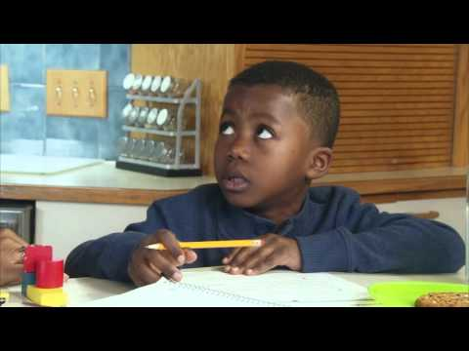
What you can do to help your students at home:

Slide 8
Other information:
www.studyladder.ca
Card games: Hit the Deck
Westboro Web: www.wboweb.weebly.com
Dice games

