Slide 1
Self-control

Slide 2
the ability to control oneself, in particular one's emotions and desires or the expression of them in one's behavior, especially in difficult situations

Slide 3
Sometimes this is hard. Why?

Slide 4
To help us, we can use strategies. One way to do this is to think of a stop light:

Slide 5
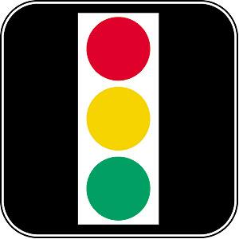

Slide 6
Red means STOP – I tell myself to calm down.

Slide 8
Yellow means I take three deep breaths

Slide 10
Green means I slowly count to ten… (and then I am good to go!)

Slide 11
1 – I tell myself to calm down
3 – I take 3 deep breaths
10 – I slowly count to 10

Slide 12
I can remember by repeating
1-3-10 to myself and thinking of this image:

Slide 13
1 – I tell myself to
calm down
3 – I take 3 deep
breaths
10 – I slowly count
to 10
1
3
10

Slide 14
https://www.youtube.com/watch?v=x_l6e6qN4o4
Benny and the Birthday Berries

Slide 15
Song - If you’re angry and you know it...

Slide 17
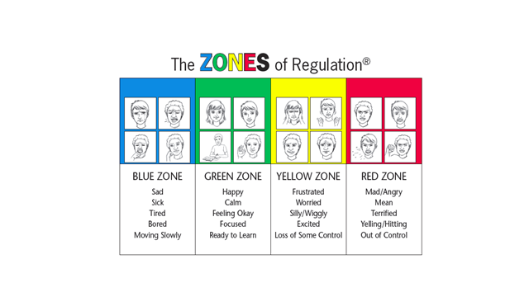

Slide 23
Self-Control Song
https://www.youtube.com/watch?v=HgKe21jlKj4

